Slide 1
Concordia University Chicago Doctoral Programs
CUC COSA Oregon Partnership

Slide 2
Degree Specializations
Community College Leadership
Curriculum and Instruction
Early Childhood Education
Educational Leadership
Educational Technology
Gerontology
Health and Human Performance
Higher Education
Organizational Leadership
Reading, Language and Literacy
Special Education
Sports Leadership
Teacher Leadership

Slide 3
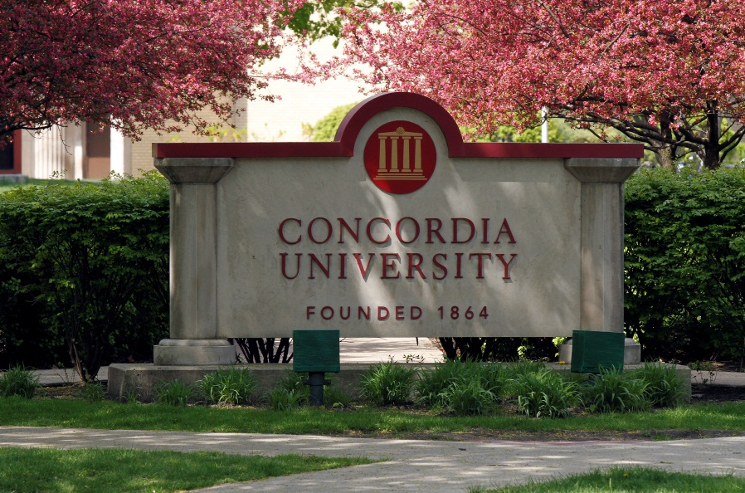
Enrollment Numbers
873 Doctoral Students
213 students are actively working on their dissertation.

Slide 4
Resources and Support
All faculty who teach doctoral level classes have a terminal degree, experience in schools and various professional organizations, and are dedicated in their support of students.
The Klinck Memorial Library is home to more than 160,000 books, audio/visual materials and periodical subscriptions, 480,000 ERIC microfiche documents, and over 80 electronic databases with remote access.

Slide 5
Collegial Cloud
An online community resource for all doctoral students & faculty
Forms
Writing resources
Sample dissertations
Dissertation recordings
Program information & announcements

Slide 7
EdD vs PhD
The EdD has traditionally been focused more on educational administration and scholarly practice.
EdD students focus their dissertation research on particular practices or policies that affect their school/district/organization. EdD students usually conduct their dissertation research within their own workplace.
EdD students generally plan to continue their work in the realm of professional practice.

Slide 8
EdD vs PhD
The PhD degree traditionally has been focused on research and scholarship.
PhD degree emphasizes theory and research methodology. PhD students take more courses related to research and conduct their dissertation research outside their own workplace.
PhD students generally pursue academic positions.

Slide 9
EdD and PhD
The National Science Foundation recognizes these degrees to be equivalent. Many college and university professors hold an EdD degree.
Both degrees are open to different methodologies (quantitative, qualitative, mixed)
Completion of both degrees requires scholarly sound work, investment of effort and time.
Academic job prospects after obtaining a degree depend on the needs of specific departments rather than types of a degree or a particular methodology.

Slide 10
Dispositions for Doctoral Studies
Students demonstrate scholarly capacities and a desire to learn; analytical and critical thinking.
Exhibit maturity, sense of responsibility, self-direction, and discipline.
Are committed to their profession/discipline.
Act collegially, professionally, and ethically.
Foster respect and maintain the boundaries of self and others.
Are open to personal growth; receive and reflect on critical feedback

Slide 11
Contact Us
http://gradschool.cuchicago.edu
Robert K. Wilhite, Ed.D.
Dean, College of Graduate Studies
Robert.Wilhite@cuchicago.edu
Maja Miskovic, PhD
Executive Director, Doctoral Programs
Maja.miskovic@cuchicago.edu
708-209-3554
Lydia Hosek
Coordinator, Division of Research and
Doctoral Programs
Lydia.Hosek@cuchicago.edu
(708) 209-3282

