Slide 1
Statewide Educator Equity Summit
September 25, 2018 Colt Gill, Director

Slide 2
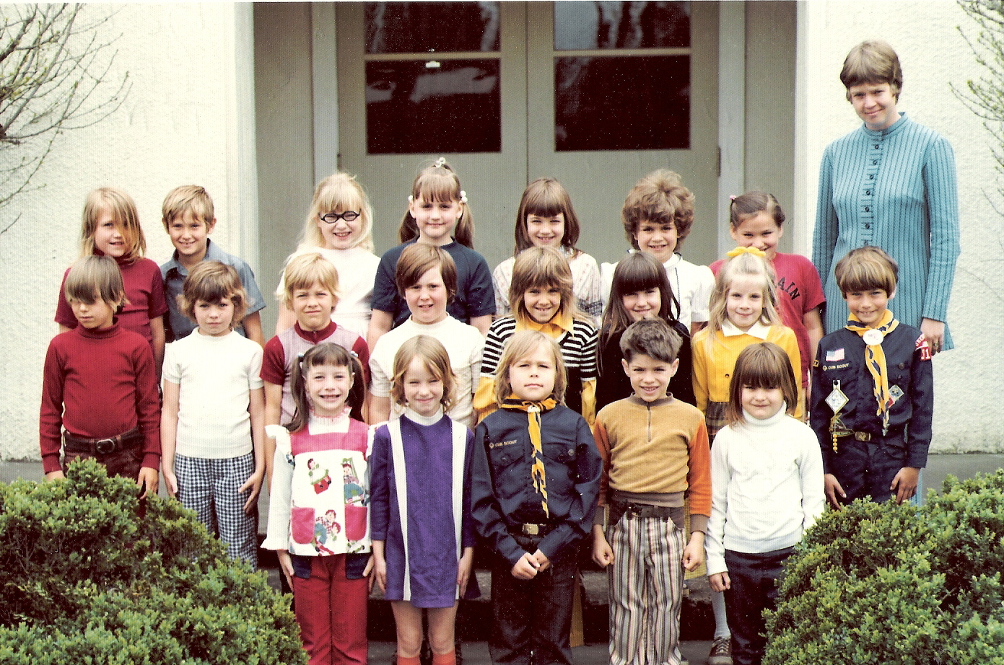
2nd Grade

Slide 3
Student Demographics
LGBT: 9%
Homeless: 3.9%
Economically Disadvantaged: 53.70%
Ever English Learners: 18.19%
Students with Disabilities: 15.02%
Mobile Students: 15.07%
Notes:
The number of students meeting the federal definition of homeless in Oregon is up for the fourth year in a row, reaching a new record for both the number and percentage of homeless students. For the 2016-17 school year, 22,541 students “lack a fixed, regular and adequate nighttime residence”. That represents 3.9% of the entire public K-12 student population.

Slide 4
colt.gill@state.or.us
@ORDeptED_Colt

