Slide 1

Notes:
Frank

Slide 2
Impact of School Leadership
Research indicates that school leader quality is the second most important school factor in a child’s academic success.
  Principals contribute up to 25% of student achievement, while teachers contribute up to 33%.
The difference between an average and an above average principal can impact student achievement by as much as 20 percentage points.
“It is the combination of highly effective teaching with highly capable school leadership that will change outcomes for children in our schools – not one or the other – but both.”
(Rainwater Leadership Alliance)
Source: Marzano, Walters, & McNulty, 2005; Leithwood et al., 2004.
Notes:
Teachers impact students in their classroom, while principals impact all students in school.

Slide 3
“They understand that the improvement of instruction is, in the end, the most important leadership challenge of our day.”
Source: Dr. Steve Fink of Univ of Washington’s Center for Educational Leadership
Notes:
Krista

Slide 4
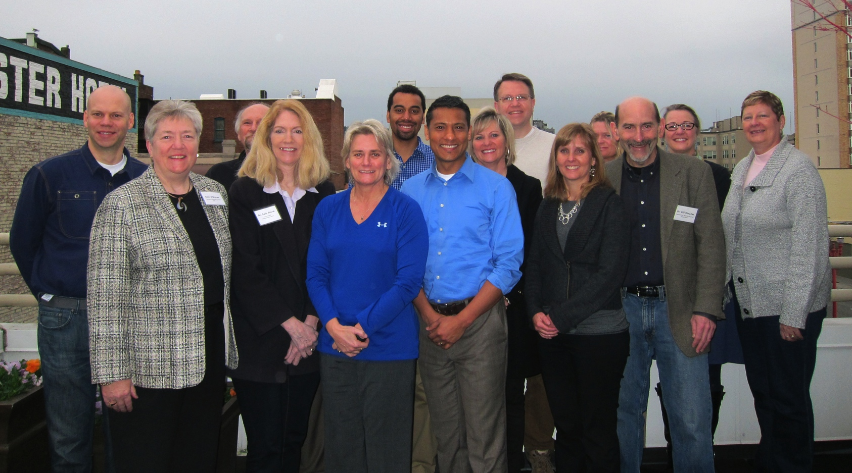
Distinguished Leaders Council
Notes:
Sue

Slide 5
Distinguished Leaders Council
Cheryl K. Brown Confederation of Oregon School Administrators Matt Coleman Springfield Public Schools Colt Gill Bethel School District Ericka Guynes David Douglas School District Bob King Crater Renaissance Academy Jay Mathisen Bend-La Pine Schools Susie Orsborn West Albany High School Erin Prince Corvallis School District | Krista Parent South Lane School District Bill Rhodes West Linn-Wilsonville School District Tracie Renwick Redmond School District Carlos Sequeria Bethel School District Kathleen Sundell Salem Keizer Education Association Sally J. Storm McKenzie School District Iton Udosenata Cottage Grove High School
Notes:
Rationale and background for DLC--Frank

Slide 6
Charge of the DLC
What would make Oregon the best place to be a school leader in the country?
  How do we address the gap in Oregon’s leader preparation practices in order to transform our current reality?
  How can we best support existing leaders to strengthen their practice?
  How can Oregon increase the diversity of people working in school and district administration?
Notes:
Frank to ???
Just a reminder what our teams’ original charge consisted of . . .

Slide 7
Principal Turnover
Among studies of principal turnover rates, there is wide variation, ranging from 50-79% of principals’ first 3-6 years at a school.
It takes from 3-6 years to see improved achievement following full implementation of a school reform strategy.
Results suggest that principal turnover has significant negative effects on student achievement.
Only 10% of school administrators are people of color in Oregon schools.
Schools with high percentages of poor, minority, and low-performing students experience more turnover than other schools.
In the recent TELL Oregon survey, school leadership was identified as the most important factor in a teacher’s willingness to continue teaching at their school.
Source: Burkhauser, et al., 2012; Louis et al., 2010; Orr et al., 2010; Fullan, 2001
Notes:
Frank or ???
School-level (i.e. school culture) than impact on classroom instruction and curriculum
The weaker impact of principal turnover on classroom variables might suggest that teacher classroom practice is in some way buffered from direct effects of changes in principal leadership.”
Burkhauser: “New principals were more likely to leave when test scores declined in their first year. Of the 61 schools that lost their first-year principals after one year, we were able to calculate aver- age gain scores for 51 of the schools for the year that principal was in place. Forty out of the 51 had experienced clear achievement declines (meaning that the score on our gain score measure of school performance was in the lowest third of our sample in at least one subject), and 11 experienced gains or no change. The fact that 78 percent of the principals who left after one year and for whom we had gain score information had experienced declines in gain scores sug- gests that at least some of early career turnover among principals that is observed may be driven by concerns on the part of district leaders or other stakeholders about principals’ performance.”

Slide 8
National Findings: Mentoring and on-the-job experience is more valuable
Notes:
Frank or ??

Slide 9
What makes an effective school leader?
Facilities management
Student discipline
Media representative
Board relations
Adaptive leadership
Culture-builder
Instructional leadership
Focus on improving student achievement
Human capital management
Emotional intelligence
Visionary
Community outreach
Accountability & standards reporting
Crisis manager
Source: Grissom et al., 2013; Marzano, Walters, & McNulty, 2006; Leithwood et al., 2004; Change Agents, 2013.
Notes:
Frank

Slide 10
Key Takeaways
Coursework and internships of leader preparation programs are typically “one-size-fits-all” and do not prepare leaders for the realities of what it takes to run today’s schools.
Programs admit nearly everyone who applies, with little collaboration with districts to intentionally recruit effective teacher leaders with the highest potential for success.
Data is limited about the placement, retention and quality of school leaders in Oregon than in many other states.
While there are pockets of exceptions, district structures and resources are constrained and do not offer widespread supports for existing administrators.
There is a growing national movement to improve preparation of new administrators and supports for existing administrators, and there is great potential to adapt promising practices to communities throughout Oregon.
The racial, ethnic and gender make-up of Oregon’s administrators does not mirror Oregon’s students.
Notes:
Frank or ???
Internships are typically on top of teachers’ existing responsibilities, and are therefore not substantive and relevant enough to teach skills that research documents as necessary ingredients for effective leadership.
Programs do not differentiate preparation by type (priority v. focus), region (rural v. urban), level (elementary, middle, high school) or position (principal v. superintendent).
We studied promising practices from around the country

Slide 11
DLC Recommendations
Supporting Current Administrators
Preparing New Administrators
Learning- Focused Supervision
Integrated, Meaningful Internships
Qualified Support Network
Relevant Coursework
Expanded Career Pathways
Rigorous Recruitment and Selection
Notes:
Back to Frank

Slide 12
Leading for Learning: A Two-Prong Initiative
Current Leaders
Partnership with University of Washington, Center for Educational Leadership to provide 18 month cohort based programs
Outcome: Every district in Oregon will have trained central office administrators
Aspiring Leaders
Partnership with an university or professional organization
Incorporate a half-time residency experience to allow each candidate to develop school leadership skills
Purpose: Increase capacity of districts to scale up from “Islands of Excellence”
4 Cohorts of at least 50 participants over four years.
Intentional recruitment and rigorous selection of candidates from historically underrepresented groups
Mentoring over first 2 years
Exploratory “pre-program” experiences to encourage a diverse candidate pool
Notes:
Frank

Slide 13
Theory of Action
If we strengthen the skills and knowledge of district and school leaders to support learning, they will have the capacity to take bold and purposeful action.
If leaders take bold and purposeful action, they will establish conditions
for effective teaching and learning.
If the necessary conditions for effective teaching and learning are established, teachers will improve their instructional practice.
If teachers improve instructional practices, student learning will increase and achievement gaps will close.
Notes:
Frank

Slide 14
Intermediate Outcomes
Improvements in 5 key elements of effective principals:
  Culture of high expectations
  Supportive climate
  Shared leadership
  Instructional improvement focus
  Managing people, data and systems
Increase in the number of people of color in school administration
Perception of school administration as a lever for systemic improvement
Higher performance ratings for both principals and the teachers they supervise
Higher share of effective principals and teachers retained
Notes:
Frankl

Slide 15
Systemic Outcomes
Higher student achievement
Smaller/eliminated achievement and opportunity gaps
Increase in the number of people of color in district leadership positions
Improvements in principal retention rates
Improvements in teacher satisfaction
State policy and practices that view school administration as a lever for systemic improvement
Notes:
Frank

Slide 16
Leading for Learning: Current Leaders
The University of Washington, Center for Educational Leadership (CEL) will provide a 18-month, high-level training that combines seminar and school-based training with a intentional focus on closing achievement gaps.
Cohorts of at least 50 existing central office administrators/principals each year for four years
Core – effectively supervising principals and creating the necessary conditions for principal success
“Decades of evidence have shown that school improvements tend not to deepen at single schools or spread across schools without substantial support from district central offices.”
(Copland and Honig, 2010)
Notes:
Frank

Slide 17
Leading for Learning: Outcomes
Participants will . . .
Develop a clearer understanding of instructional leadership and the supports necessary to improve it at scale.
Understand and be able to create the structures and routines necessary to improve the performance of principals as instructional leaders.
Develop the skills necessary to use teaching and coaching as a primary lever for improving principal performance.
Develop the routines and structures of successful learning communities to support their work together.

Slide 18
Cohorts 1 and 2
118 central office staff participating
35 school districts participating
44% K-12 students impacted

Slide 20
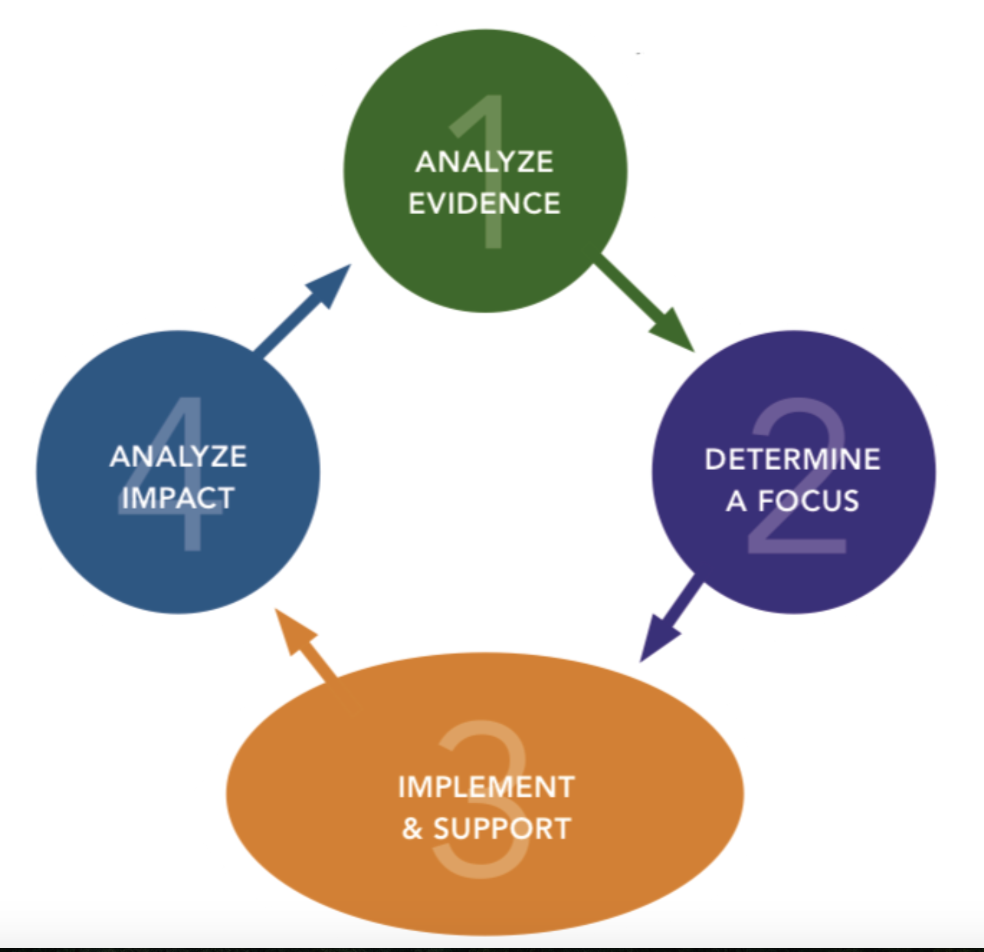
Cycle of Inquiry

Slide 21
Phase I: Analyze Evidence
STEP 1: Gather School Wide evidence and identify student learning and teaching practice successes and problems
STEP 2: Analyze School Wide evidence of student learning to identify teaching practices strengths and problems.
Phase II: Determine a Focus and Action Plan
STEP 1: Correlate the evidence of student learning and teaching practices to determine a focus.
STEP 2: Generate a theory of action (action plan)
STEP 3: Principal Leadership to determine areas of instructional leadership focus
STEP 4: Determine evidence of success

Slide 22
Phase III: Implementation, Monitoring and Support
STEP 1: Create a learning plan for principal implementation and district personnel support.
Step 2: Implement the Learning Plan
Phase IV: Analyze Impact
STEP 1: Analyze student and teacher evidence.
STEP 2: Analyze principal leadership practice evidence.
STEP 3: Prepare a written analysis for reflection and feedback.

Slide 23
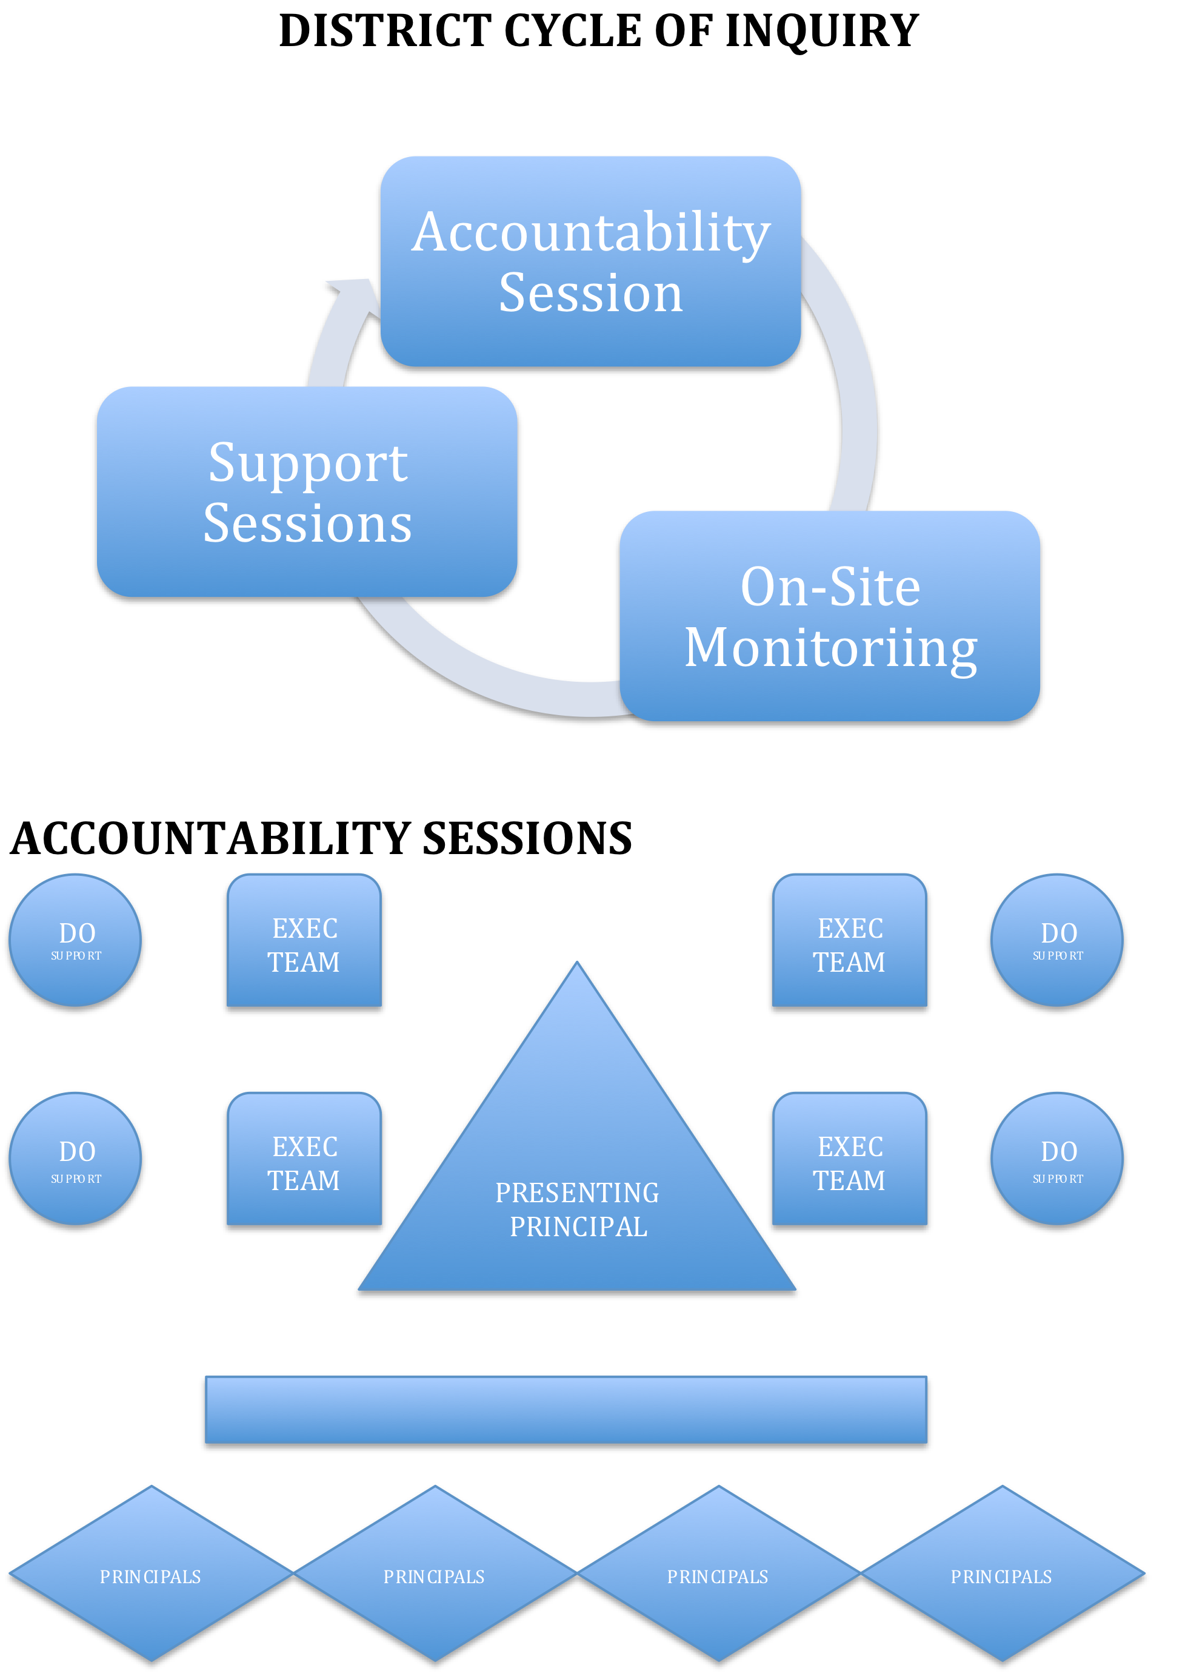

Slide 24
Watching Principal Support in Action
https://vimeo.com/111875004

Slide 25
Leading for Learning: Aspiring Leaders
2014-15 school year for planning & preparation
Identify university partner(s)
  COSA-Concordia and PSU
Selection and recruitment of diverse candidates
(will seek 100 applicants and choose up to 30)
Guaranteed half-time release for full year or full time release for half year
Each candidate paired with a highly trained mentor
Mentor/Coach support beyond program
Rigorous and relevant coursework
Notes:
Frank & Erin

Slide 26
Leading for Learning: Next Steps
Current Leaders:
Cohort 3 expected start August 2016
Aspiring Leaders:
Grant awarded Dec. 2015
Recruitment for candidates now
Applications open February 2016
Programs begin Spring 2015-16
Residencies begin 2015-16 school year
Notes:
Frank and all

Slide 27
Reflections
What are some current barriers that are getting in the way of you or your principals from getting into classrooms on a regular basis?
Share strategies you have found to help building leaders prioritize time spent with teachers.
How do you see this type of support for district level administrators impacting instructional leaders in the buildings?

Slide 28
Notes:
Frank

