Slide 1

Opportunities & Challenges for in Oregon’s Early Learning System
COSA Winter Conference
January 2016

Slide 2
Profiles of readiness
Profile Name | N | % of entering kindergartners | Characteristics
+ ATL/ + ACADEMICS | 10,051 | 25% | 35% economically disadvantaged; 6% ELL
- ATL/ - ACADEMICS | 10,197 | 25.5% | 72% ecn. dis.; 33% ELL
-ATL/+ACADEMICS | 7,381 | 18% | 38% female; 10% ELL
+ATL/-ACADEMICS | 6,724 | 17% | 57% female; 25% ELL
Very Lows | 1,796 | 4.5% | 71% ecn. dis.; 37% SPED; 26% female
Super Regulators | 3,918 | 10% | 67% female; 3% SPED

Slide 3
So what?
The very lows start behind academically and develop slowly across their kindergarten year.
The +ATL/-ACADEMICS and the very lows start at similar places but the +ATLs develop more in their kindergarten year. Some see more growth than kids who are +/+.
Kids without self regulation (-ATL/+ACADEMICS; very lows) have the highest levels of conflict with their teachers throughout the year.

Slide 4
Our children
There are 45,000 children born in Oregon each year. Medicaid pays for half of those births.
There are approximately 230,000 children under the age of five in Oregon.
At least one in four children under 5 are exposed to a well known set of risk factors - poverty, abuse, neglect, unstable housing.

Slide 5
Changing Demographics

Slide 6
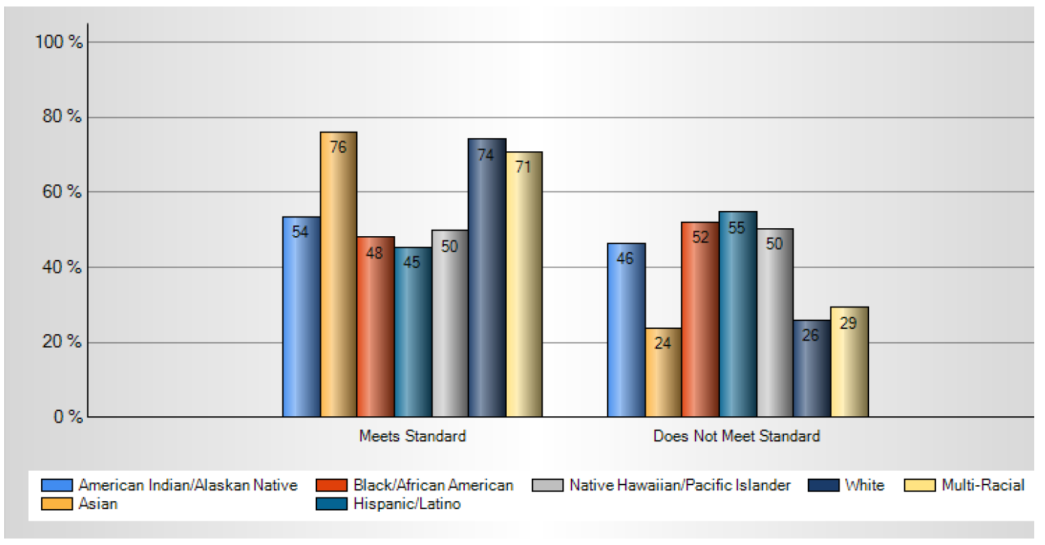
Disparities in grade level literacy at third grade

Slide 7
Disparities in our four year cohort graduation rate

Slide 8
Inadequate Prenatal Care - 2014
Less than five prenatal visits or care began in third trimester

Slide 9

Well-baby/Well-child Visits
Measure is the percentage of children who had six visits with health care provider prior to 15 months of age.
Statewide performance on this measure declined. The decline can likely be attributed to the small denominator in 2013 and may also be due to new members not receiving all six visits in 15 months.
71.6% received four visits.
63.8 % received five visits.

Slide 10
Accessing Quality Child Care
4 Star
Licensed
3 Star
Commitment to Quality
5 Star
Licensed-exempt
Licensed-exempt receiving subsidy
Where are the children?
8,852
27,928
100,455
7,276
??????

Slide 11
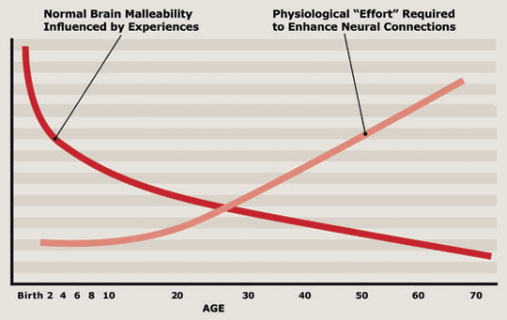
The importance of brain-building

Slide 12

The Neuroscience behind Culturally Responsiveness

Slide 13

The intersection of Neuroscience and Culturally Responsiveness

Slide 14
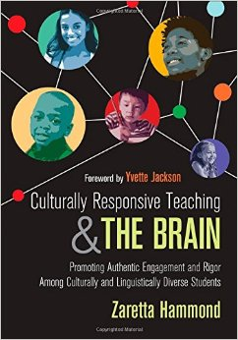
Culturally responsiveness is not a practice; it is what informs our practice so that we can make better teaching choices for eliciting, engaging, motivating, supporting, and expanding the intellectual capacity of Each Child.

Slide 15
Activity

Slide 16
“Brains grow best in the context of supportive relationships, low levels of stress, and through the creative use of stories. While teachers may focus on what they are teaching, evolutionary history and current neuroscience suggest that it is who they are and the emotional environment in the classroom they are able to create that are the fundamental regulators of neuroplasticity.”
Excerpted from The Social Neuroscience of Education, ©2013 by Louis Cozolino.

Slide 17
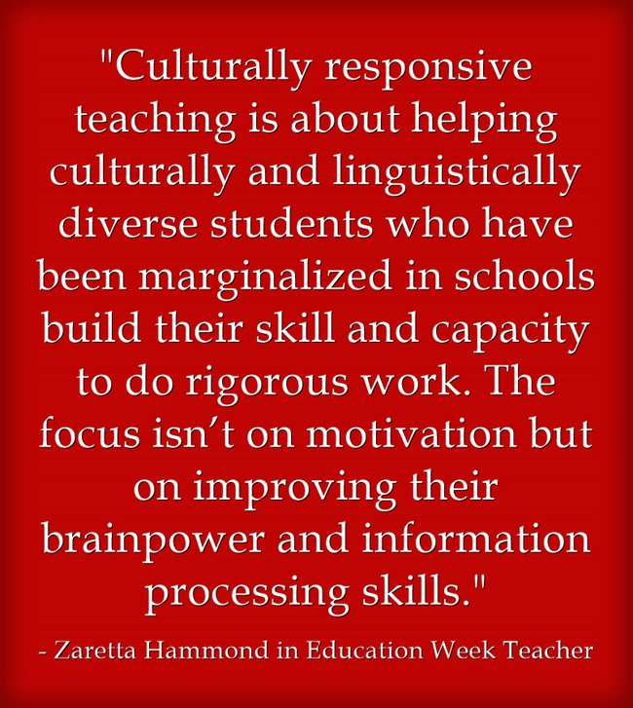
Reimaging our Learning Environments

Slide 18

The Science of
Brain Building & Vroom

Slide 19

Infant Brain Development
At birth, the infant’s brain is the most immature organ in the body.
Environment determines how the infant’s brain will grow and develop.
How the baby’s brain will develop is highly determined by the quality of the relationships the baby experiences.
This is both an opportunity and a vulnerability.

Slide 20
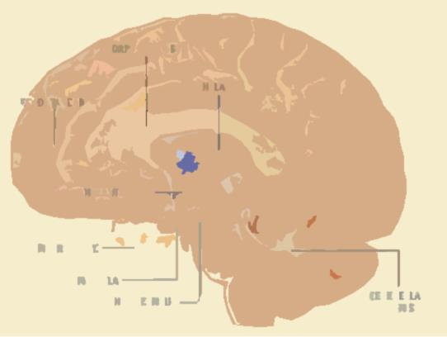
Brain Weight by Age
Whole Brain Weight (grams)
Age (note different units)
Notes:
A child’s brain more than doubles in mass during the first year after birth and reaches 80% of its adult size by 2 years of age.

Slide 21
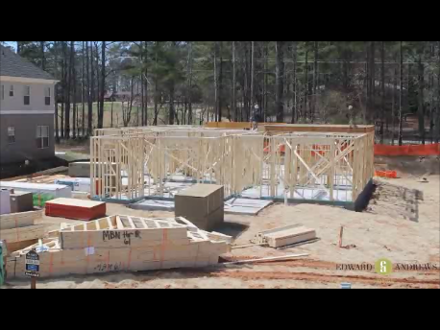
Brain Development Is Sequential
Notes:
Brain growth & development is sequential. Like building a house, early brain development lays the foundation for all future development. The quality of that early brain development carries forward and determines the quality of the brain development that follows. Without repair, how an infant’s brain develops sets the path for that child’s development throughout the child’s life. This is what is meant by the earlies years of brain development are both an opportunity to set into motion optimal development as well as a vulnerability if the environment is not filled with quality relationships. Its much easier to build it right the first time than to fix it later.

Slide 22
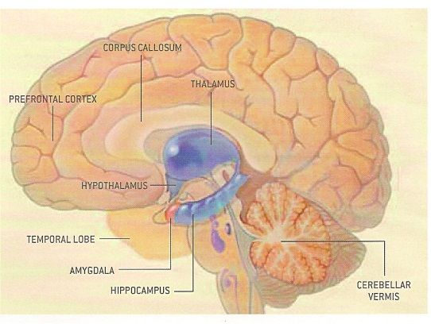
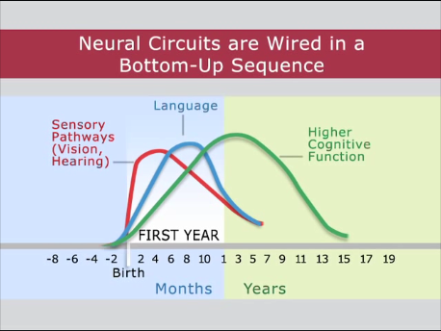
Sequential Brain Development the First Three Years
National Science Council of the Developing Child
Center on the Developing Child
Harvard University

Slide 23

Attachment and Brain Development
Humans are social beings hardwired for relationships with others.
Babies are born seeking human connections.
Children learn in and from relationships.
A child’s first teachers are Mother, Father or other caregiver.
An infant must be in a nurturing and affectionate relationship with a caring adult for healthy social, emotional, mental, physical and cognitive development.

Slide 24

The Importance of Serve and Return
National Science Council of the Developing Child
Center on the Developing Child
Harvard University
Notes:
http://developingchild.harvard.edu/resources/serve-return-interaction-shapes-brain-circuitry/

Slide 25





Promoting Brain Building Moments
So how can we promote brain building moments in our busy lives?

Slide 26
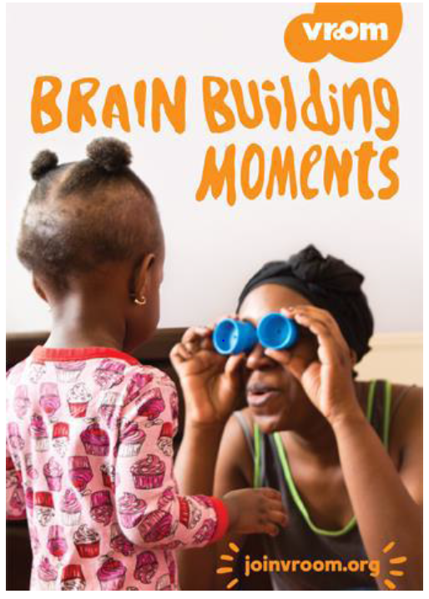
Vroom
Vroom is a powerful way to prompt simple, everyday moments of parent-child serve and return interactions that are fun and great brain building activities.
Based on the latest science and designed to fit into parents’ existing routines, Vroom can be accessed via its Smartphone app or other free materials in both English and Spanish. You can read more at the Vroom website: www.joinvroom.org
The Early Learning Division has partnered with the Bezos Family Foundation to launch Vroom in Oregon. Oregon is one of several states across the country to role out Vroom to a larger audience. Currently, there are 20 pilot sites spread across the state of Oregon promoting Vroom in their communities.

Slide 27
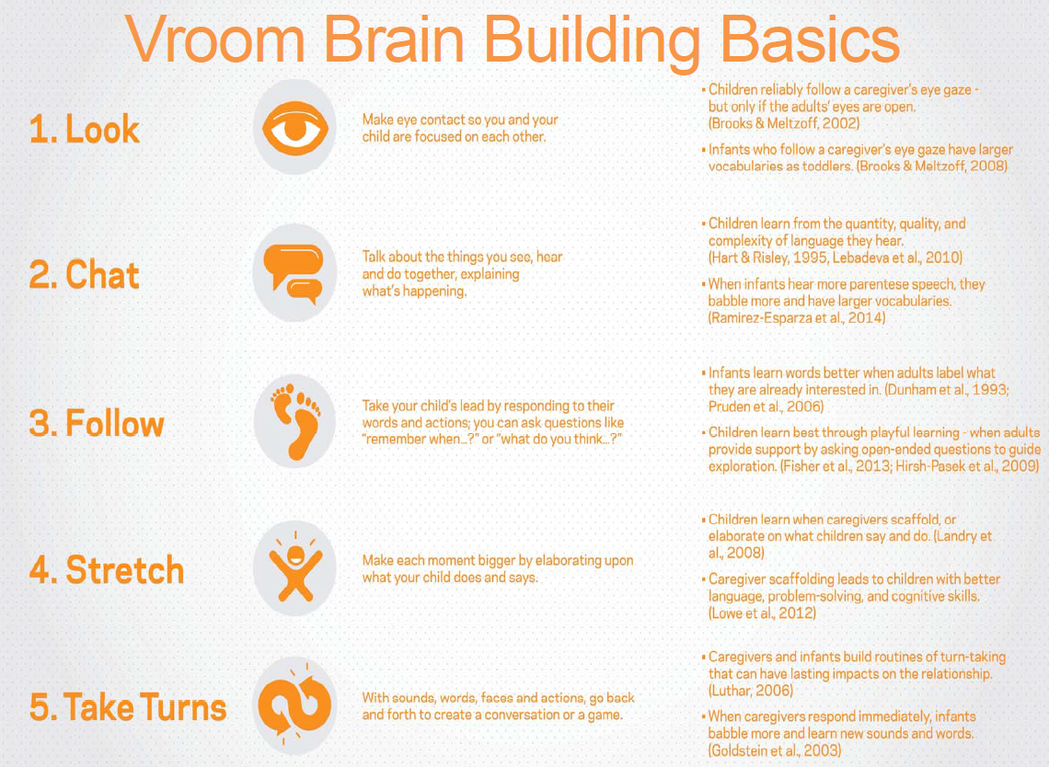

Slide 28
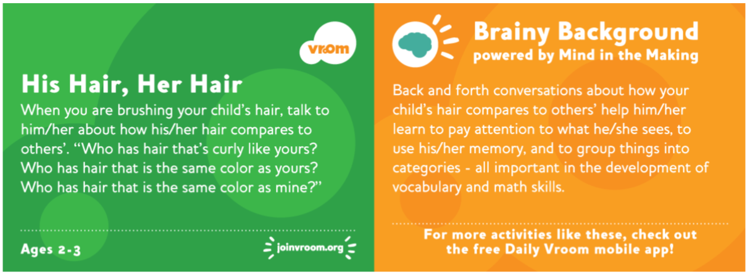
Brain Building Basics in Action
The Brain Building Basics (Look, Chat, Follow, Stretch, Take Turns) were created to break the science down into actions that can turn any moment into a brain building moment. Let’s take a look at how the following Vroom activity utilizes all five of the Brain Building Basics.

Slide 29



Vroom Positively Impacts Families
“A young, at-risk father that completed this series told us at its conclusion that he was so grateful to have been introduced to Vroom. “It has enriched the time I spend with my daughter,” he said.”
–Early Learning Hub of Central Oregon

Slide 30
Thank you!

