Slide 1


Slide 2
Quickwrite
Pretend you are having a conversation with a recent graduate from your district. What do you hope they would say about how their K-12 experience prepared them for a rigorous postsecondary education?

Slide 3
Districtwide
Schoolwide

Slide 4
Districtwide AVID
Districtwide AVID is aligning District resources and planning to support the quality and sustainable schoolwide implementation of the AVID system at schools K-12.
Districtwide AVID alignment reduces the variability experienced by all students in K-12 system resulting in graduates who have had access to rigorous instructional opportunities and are college ready.

Slide 5
Superintendent and BOE establish the foundational belief system and support the culture that all students can be successful
District leadership sets vision for Districtwide AVID
-District leadership commitment
AVID college readiness culture becomes an integral part of the
District
Strategic
Plan
Leadership Commitment and Accountability
Establish District Infrastructure and Systems
Ongoing Evaluation Systems
K-12 Instructional and Accountability to Support Sites

Slide 6
Leadership Commitment and Accountability
  •Site Principal is an active member of the
  leadership team and is committed to fidelity
  •Site Leadership team is committed to
  implementation and sustainability with
  fidelity

Slide 7
ACTIVITY
Take a few minutes and reflect on the Leadership part of the Districtwide graphic tool with the following question:
  What are some best practices you are currently doing with this aspect of Schoolwide?
Notes:
Brief report out to bring finality to conversations

Slide 8
Establish District Infrastructure and Systems
  • DD selection
  • District level Visioning team-sustainability
  plan
  • Community Partnerships
  • Resource Allocation

Slide 9
ACTIVITY
Take a few minutes and reflect on the Systems Infrastructure part of the Districtwide graphic tool with the following question:
  What are some best practices you are currently doing with this aspect of Schoolwide?
Notes:
Brief report out to bring finality to conversations

Slide 10
Ongoing Evaluation
Systems
  •Defined data points to support AVID’s
  integration into the District’s continuous
  improvement cycle
  •Number of AVID sites and successful
  Certification

Slide 11
ACTIVITY
Take a few minutes and reflect on the Ongoing Evaluation Systems part of the Districtwide graphic tool with the following question:
  What are some best practices you are currently doing with this aspect of Schoolwide?
Notes:
Brief report out to bring finality to conversations

Slide 12
K-12 Instructional and Accountability to Support Sites
  • Integrate AVID with District Adult
  Professional Learning Plan
  • WICOR language
  • Leverage strategies
  • WICOR integration with other academic
  priorities

Slide 13
ACTIVITY
Take a few minutes and reflect on the Instructional part of the Districtwide graphic tool with the following question:
  What are some best practices you are currently doing with this aspect of Schoolwide?
Notes:
Brief report out to bring finality to conversations

Slide 14
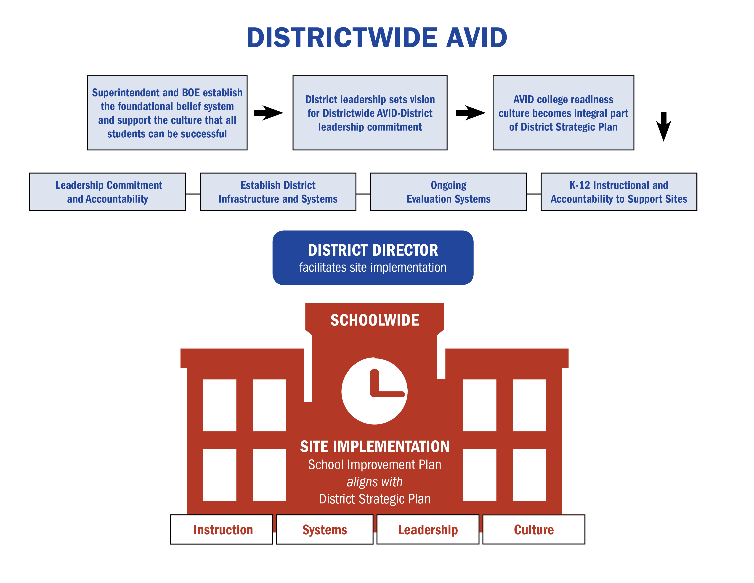
Districtwide AVID

