Slide 1

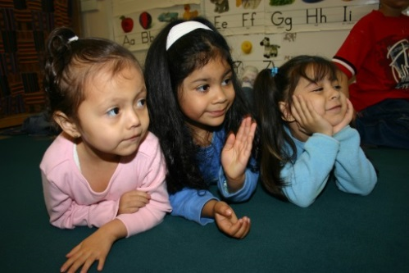
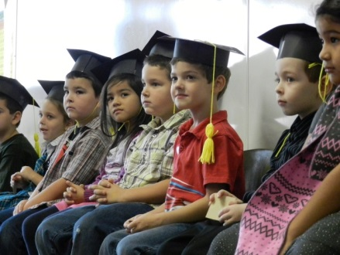

Raising the Bar of Educational Excellence:
Fostering the connection Between Early Learning & K-3 Education in Oregon
COSA Principal’s Conference | October 26, 2015

Slide 2
Objectives
During today’s session, you will:
Be introduced to some of the major aspects of Oregon’s early learning system transformation
Provide feedback on a statewide effort to align early learning and kindergarten standards.

Slide 3
Early Learning Division
Division within ODE, with direct reporting line to the Governor
Manage $30m federal Race to the Top Early Learning Challenge Grant
Supporting all of Oregon’s young children and families to learn and thrive
Responsible for ensuring high quality early learning and care experiences for all children through child care licensing, workforce development, and Oregon’s Quality Rating & Improvement System
Responsible for leading all aspects of Oregon’s early learning system transformation

Slide 4
Equity Breakthrough
Anti-bias workforce
Culturally responsive communications
Data collection
Professional development

Slide 5
Early Learning Hubs
Facilitate cross-sector collaboration
Early learning, K-12, health care, human services, and private sector
Are accountable for improving outcomes
Operationalize Oregon’s Equity Lens
Identify children and families in need of support
Stable and attached families, children ready for kindergarten, and coordinated and effective systems
Make resources, supports, and services more available, accessible, and effective

Slide 6
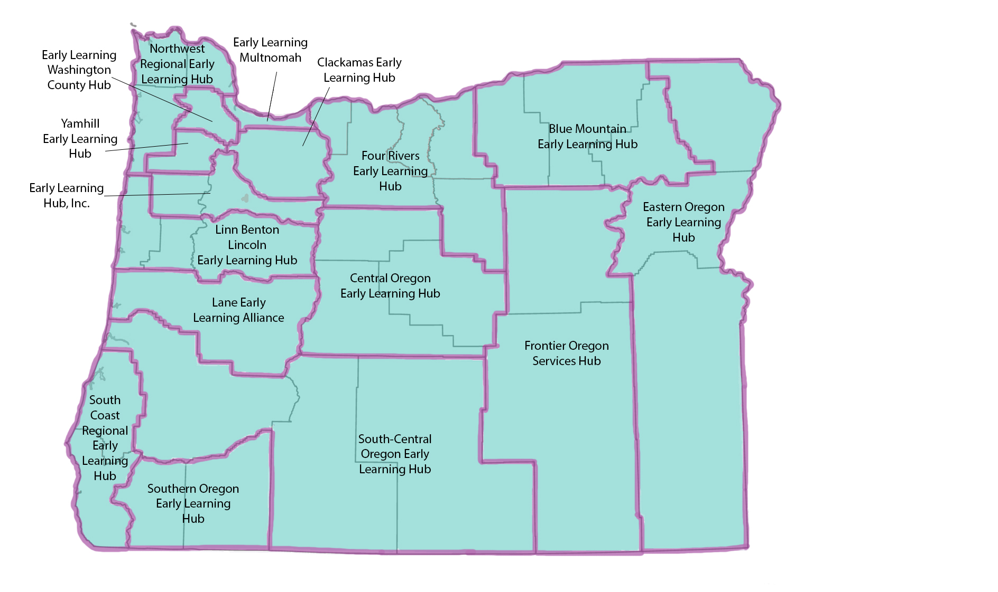
The Hub Map

Slide 7
Preschool Promise
New $27m State General Fund investment to increase access to Pre-K
Mixed-delivery service model
Approximately additional 1400 children served in high quality Pre-K settings
2016-17 pilot year

Slide 8
Early Learning/Kindergarten Partnership & Innovation
$9.1m State General Fund investment to deepen connection between early learning and K-3
Funds flow through early learning hubs
Priorities areas are kindergarten transition, family engagement, and shared professional development
Develop scalable/replicable models for local PreK-3 alignment

Slide 9
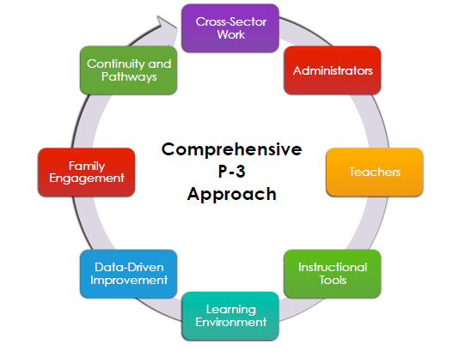
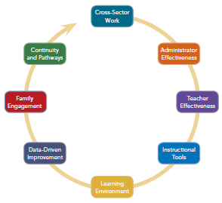
P-3 Alignment Framework
Kauerz, K. and Coffman, J. (2013). Framework for Planning, Implementing, and Evaluating PreK-3rd Grade Approaches. Seattle, WA: College of Education, University of Washington.

Slide 10
What are we aligning?
Standards, curricula, instruction, assessment, and professional development are strongly connected within and across grades from Pre-K through Third Grade
Standards, curriculum, instruction, assessment, and professional development focus on both social competence and self-discipline as well as academic skills

Slide 11
Project Goals
Clearly articulate how the domains of Oregon’s early learning and development standards align with Oregon’s academic standards for kindergarten.
Ensure that the products are culturally responsive and help close access and opportunity gaps
Develop a set of tools and resources to support the implementation of aligned standards across the P-3 continuum

Slide 12



Oregon’s Early Learning and Kindergarten Standards
Kindergarten Transition
Aligned Standards for Children Ages 3 to Kindergarten

Slide 13
Domains
Approaches to Learning
HS Framework + New Standards for K
Social-Emotional Development
HS Framework + New Standards for K
Language & Communication
Literacy
Math
HS Framework + CCSS ELA-K
HS Framework + CCSS ELA-K
HS Framework + CCSS Math-K

Slide 14
Guiding Values
Equity
  Equity of voice
  Culturally responsive practice
  Closing access & opportunity gaps
Learn from others
  Local standards alignment efforts
  Other states
Respect different funds of knowledge, experience, and perspectives
Balance ‘developmentally appropriate’ and ‘academic vigor’
Isolate standards from curriculum, instruction, and assessment (for now)

Slide 15
Project Recap To Date
March 2015: Project launched in March with a 35+ member work group consisting of experts from early learning, K-12, and the research community.
April-June 2015: Four small work groups drafted aligned standards language for the domains of language, literacy, math, and social-emotional development/approaches to learning.
June 23-24, 2015: In-person, work group decided to:
  Use new Head Start Learning Outcomes Framework as the foundation for aligned standards
  Include domain-level introductory narrative
  Include age level progressions
July 2015: Initial working draft language was shared with the work group via webinar. Key areas for feedback included:
  How inclusive is draft language of multiple settings?
  How culturally responsive is the draft language?
  How effectively does draft language address accommodations/differentiation for children who receive special education services?

Slide 16
Project Recap to Date, cont.
August 18, 2015: Workgroup convened for one day in-person session. Broke into five small groups focusing on:
  Learning Progressions
  Equity Lens
  Supports for Children With Disabilities
  How adults can support children’s learning
  Domain Narrative & Document Introduction
September-December, 2015: In process of receiving and incorporating feedback on the working draft from:
  National TA provider/consortium with expertise in dual language learners
  EI/ESCE and K-3 special education
  Head Start/Oregon Pre-K
  K-3 principals and teachers
  A wide range of community-based organizations and stakeholder groups throughout the state

Slide 17
Next Steps
Staff are in the process of revising the working draft based on recent feedback
Phase II of the project
  Stakeholder engagement
  Resource development
  Translation
  Design
  Launch (Spring 2016)

Slide 18
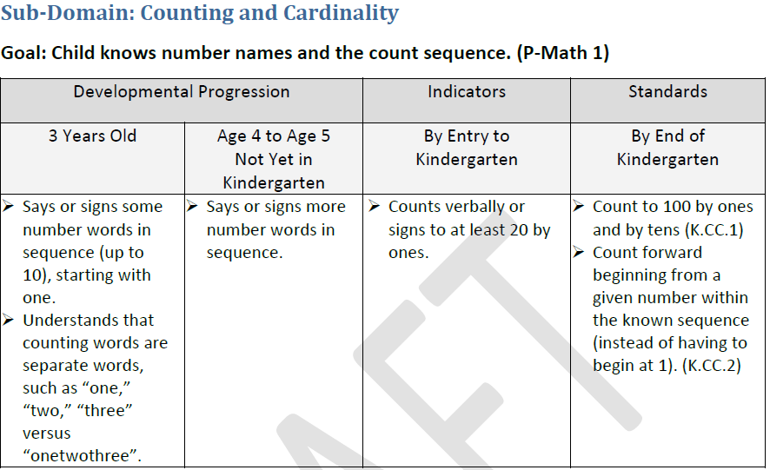
Standards Alignment Draft Structure
U.S. Department of Health and Human Services (2015). Head Start Early Learning Outcomes Framework Ages Birth to Five. Washington, DC: Administration for Children and Families Office of Head Start
Notes:
Each domain contains a brief introductory narrative, followed up a series of sub-domains broken down into a series of specific skills that align developmental progressions for children ages 3-5, kindergarten entry indicators, and Common Core State Standards (for ELA and math domains), and suggestions for how adults can help support children’s learning and development in each domain.
You’re looking at an example from the Math domain. On the left hand side you see developmental progressions for children ages 3-5 who are not yet in kindergarten that relate to the goal of the child knowing number names and counting sequences. These progressions are based on the new Head Start Learning Outcomes Framework, which came out earlier this year and which our work group adopted as the foundation for it’s work.
On the far right hand side what you see are Common State Standards for end of kindergarten that relate to the goal of children knowing number names and the count sequence and which align with the learning progressions identified for children ages 3-5. In other words, if children are saying or saying some number words in sequence when they are three years old, and then saying or signing more number words in sequence when they are 4, we can reasonably assume that they are on the right track to be able to count by ones and tens to 100 when they finish kindergarten.
What we’re really excited about that’s coming out of this work is what you see in the third column titled ‘indicators,’ which serve as guidelines for what we would expect to see of a typically developing child in each skill area as they are enter kindergarten. When all of the skills across each of the five domains included in this alignment document are taken together, it gives us a nice picture of what some of the key aspects of kindergarten readiness looks like. This is something that we haven’t previously articulated at the state level, and it provides a really foundational tool for supporting the work of aligning early learning and K-3 instructional practices at the local level and for ensuring that children are making successful transitions into kindergarten.

Slide 19
Review of Working Draft
In small groups…
Review the draft and respond to the feedback questions on the following slide
Capture the group’s thinking on chart paper

Slide 20
Feedback Questions
What do we need to do to ensure that the standards are culturally responsive and accessible for all learners?
What would you need to make this come alive in your building?
What additional supports would kindergarten teachers need?
What’s missing?
How would aligned standards fit into your school’s goal setting processes and/or professional learning communities?

Slide 21
Small Group Report Out
Please share your group’s top two takeaways
Please make sure to hand in your group’s feedback and copies of the working draft

Slide 22
Contact Info
Lillian M. Green | Equity Director / Directora de Equidad
EARLY LEARNING DIVISION / DIVISIÓN DE APRENDIZAJE TEMPRANO | OREGON DEPARTMENT OF EDUCATION
OFFICE/ OFICINA 503.947.2516 | MOBILE/ MÓVIL 971.718.6785
Lillian.green@state.or.us
Brett Walker| P-3 Alignment Specialist
EARLY LEARNING DIVISION | OREGON DEPARTMENT OF EDUCATION
OFFICE 503.378.5160 | MOBILE 971.273.8239
Brett.walker@state.or.us

