Slide 1
Presentation: A smart approach Partnering with Schools and Communities to Improve Reading Outcomes for Oregon Children
COSA Principals Conference – Oct. 21, 2013

Slide 2
Speakers
Jessica Corcoran, SMART Communications Director
Diane Turnbull, SMART Central Area Manager
Rosemary O’Neil, Mountain View Elementary Principal

Slide 3
Statewide Overview
Jessica Corcoran, SMART Communications Director

Slide 4
About SMART
Oregon business leaders concerned about literacy
Model developed to improve reading outcomes and engage community:
One-on-one reading support
Books for kids
Community-based model engaging Oregon citizens to support schools and students
Launched in 1992 – 8 schools in Portland & Bend
Notes:
By design, we are not a curriculum based model – but rather, understanding there’s a time and a place for developing softer skills around the edges that help children learn: confidence, enthusiasm, grit, etc.
K-3 initially – moving more to emphasis on PreK/K

Slide 5
SMART by the Numbers
Since 1992:
108,000 volunteers
160,000 children served
2+ million books given away
3+ million hours spent reading with kids

Slide 6
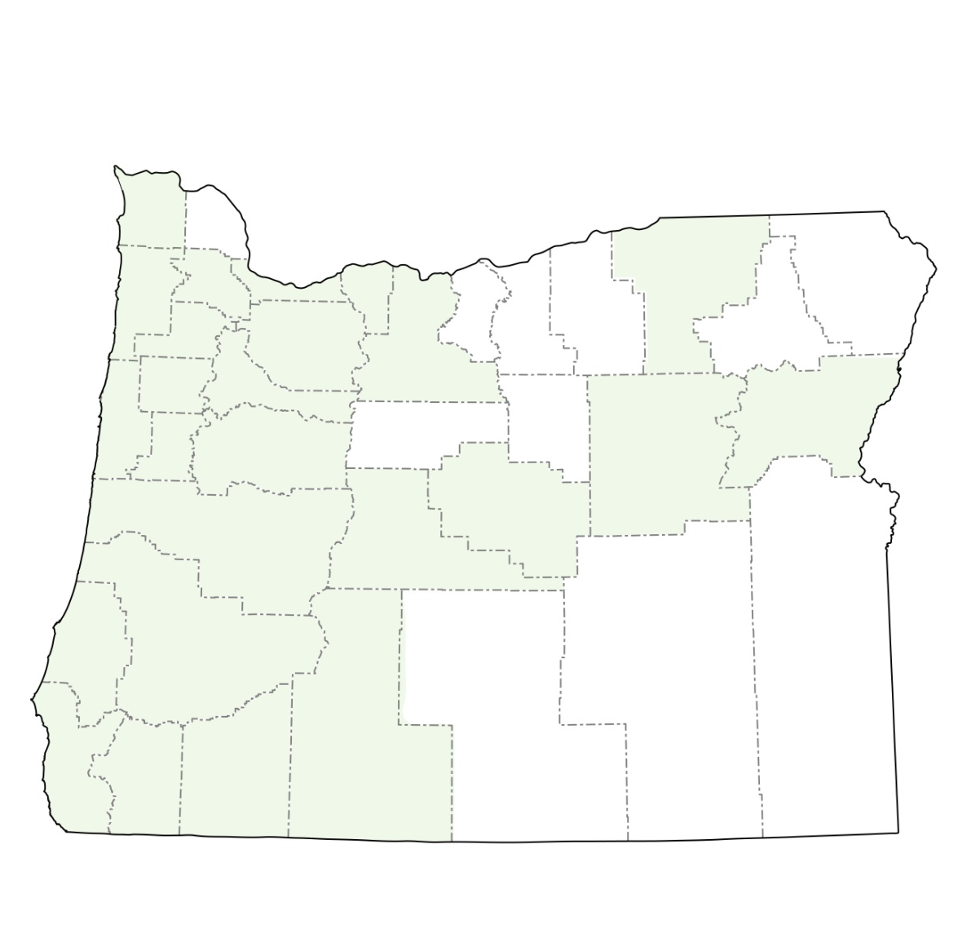
2013-14 School Year
9,000 children
272 sites
5,000 volunteers
27 counties
126,000 books

Slide 7
Outcomes
Eugene Research Institute
Independently commissioned gold-standard study
SMART students 60% more likely to meet reading benchmarks
2012-13 Year-end Surveys
Principals and Teachers:
95% felt SMART contributed to school’s literacy outcomes
91% felt that students benefited significantly from SMART
Parents: 90% said SMART helped their child become a stronger reader
2012-13 Student Milestones
90% of students in SMART showed increases in enthusiasm about reading, eagerness to interact with books, self-esteem and confidence

Slide 8
SMART in the Statewide Landscape
Education reform top priority for Oregon
Where can SMART help?
Early Literacy Initiative
Investments to improve kindergarten readiness and 3rd grade reading proficiency
Programs that foster joy of literacy
Support for lowest achieving schools (Focus and Priority)
Currently serving 26 of 68 sites - ~38%

Slide 9
SMART Implementation
Diane Turnbull, SMART Central Area Manager

Slide 10
SMART 101
PreK-3rd grade students
Mid-October to mid-May
Volunteers
Roles: Site Coordinators & Readers
Screening
Training
Students
One hour of consistent, one-on-one reading time weekly
Choose up to 2 books each month to keep (14 per year)

Slide 11
School Partnerships
School partnership established
Principal determines priorities for service
Teachers select students to participate (in Standard Model) who:
Need additional help with comprehension, fluency and accuracy
Have limited books in the home
Need of one-on-one relationships with caring adults
Aren’t served in other programs

Slide 12
Delivery Models
Standard SMART
K-3
Pull-out model serving students selected to participate
Two 30-minute reading sessions per week
PreK SMART
PreK only
Serves entire classroom
Three 15- to 20-minute reading sessions per week
KSMART
Kindergarten only
Serves entire classroom
Three 15- to 20-minute reading sessions per week

Slide 13
Changing with the Times
Increase PreK and kindergarten service
Learn about populations served
Remain flexible and adaptable to changing school needs and regulations
Support school and student priorities
Common Core

Slide 14
Principal’s Perspective
Rosemary O’Neil, Principal, Mountain View
Elementary, Corvallis

