Slide 1
Turnin' the Thing Around: How we did it and how you can do it.
Hines Middle School
Harney School District #3
Eric Nichols--Principal

Slide 2
You need a scratch piece of paper….
Number 1 to 3

Slide 3
A budget ________ occurs in years when expenditures exceed revenues.

Slide 4
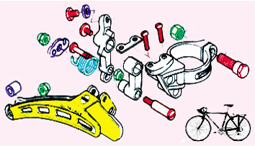
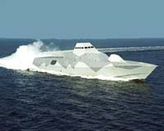
What do you call businesses with few owners that usually share responsibilities to match their strengths?

Slide 5
What do you call it when increased inputs do not lead to increased productivity?

Slide 6
ANSWERS

Slide 7
89. A budget deficit occurs in years when expenditures exceed revenues.

Slide 8
43. What do you call businesses with few owners that usually share responsibilities to match their strengths?
partnerships

Slide 9
40. What do you call it when increased inputs do not lead to increased productivity?
Diminishing returns

Slide 10

One of the strategies to

Slide 11
“Would you be interested in the middle school principal position?”
Monday-August 8, 2011—3pm
(6.5 days until teachers begin)
Now What?

Slide 12
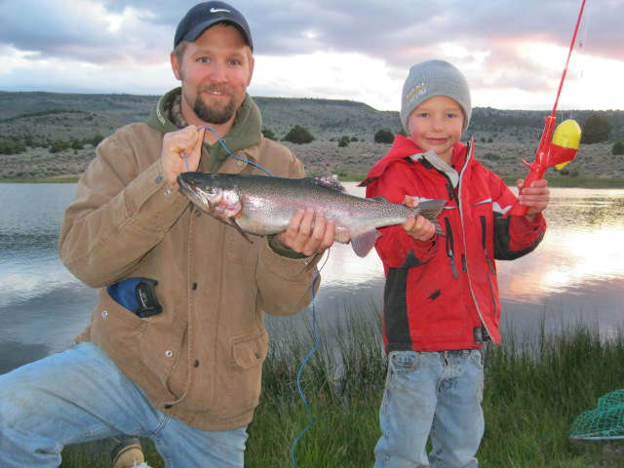
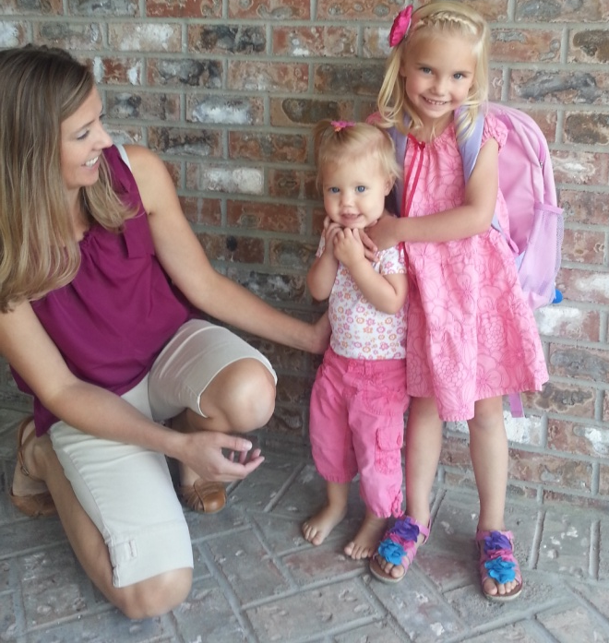
Who Is this Guy???
Eric Nichols, BS & MA
Principal—Hines Middle School, Director of Instruction & Information Services—Harney School District #3
8 year old boy, 4 year old girl and 17 month old girl
Married to Kindergarten teacher from Burns
Notes:
My bio, be brief

Slide 13

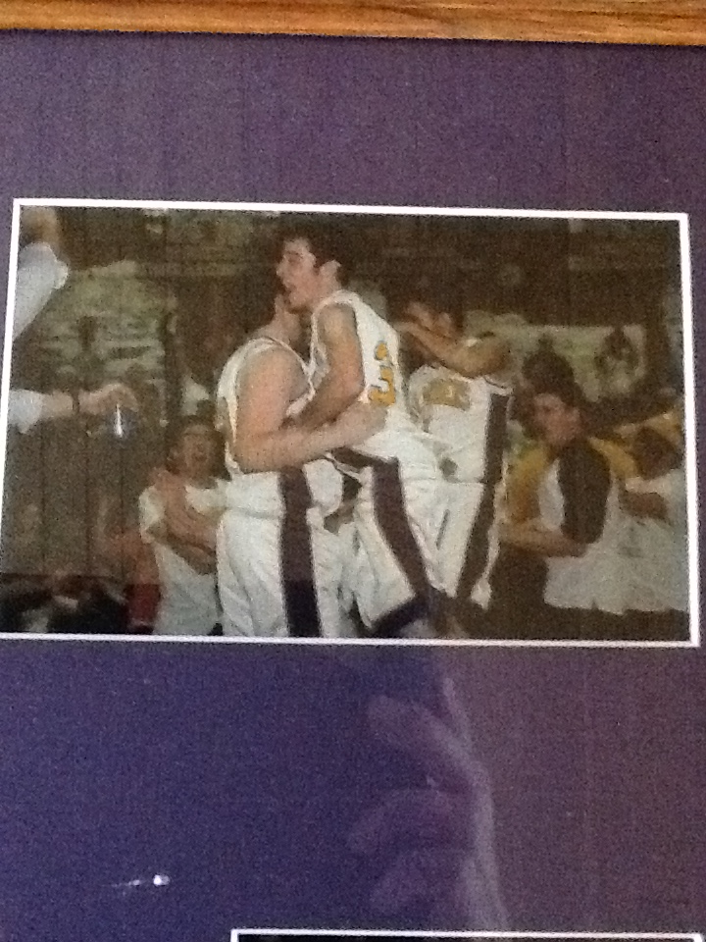

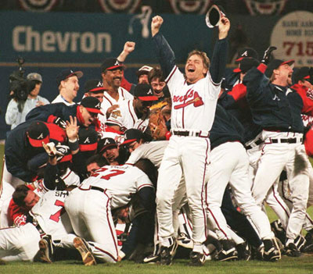

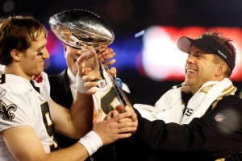


Slide 14
Objectives…
To help you help yourselves…
To help you find ways to make your job easier…
To reinforce what you may all ready be doing…
Give you tools that you can adapt and use in your classrooms/school…

Slide 15



Step 1: Assess the situation
School Year 2011-2012
Facts:
  HMS is in School Improvement
  Safe Harbor had been reached—improved by 10%ish in SPED—Reading/Math
  & overall Rdg/Math
  Dr. Kevin Feldman/Harney ESD/School Coach have done several professional development trainings previous year

Slide 16
Step 2: Immediate Response
How do we get out of school improvement?
Create Buy-In

Slide 17
Our Goals
By June 2012, we will improve the performance of 6th, 7th and 8th grade students with disabilities at Hines Middle School to meet the benchmark in Reading as evidenced by the 2011-12 OAKS Statewide Assessment. To achieve “Safe Harbor” in Reading, we will increase the percentage of Students with Disabilities meeting the benchmark from 44% in 2010-11 to 50% in 2011-12 on the OAKS assessment. Additionally, we will narrow the gap between students with disabilities and regular education students by 5% over the previous year.
By June 2012, we will improve the performance of 6th, 7th and 8th grade students with disabilities at Hines Middle School to meet the benchmark in Math as evidenced by the 2011-12 OAKS Statewide Assessment. To achieve “Safe Harbor” in Math, we will increase the percentage of Students with Disabilities meeting the benchmark from 62.96% in 2010-11 to 66.6% on the OAKS assessment. Additionally, we will narrow the gap between students with disabilities and regular education students by 5% over the previous year.
By June 2012, we will improve the performance of all 6th, 7th and 8th grade students at Hines Middle School to meet the benchmark in attendance as evidenced by their attendance percentage meeting at minimum of 94.0 percent. Students with disabilities will be at a minimum of 93 percent. These goals are monitored biweekly by grade and incentives are offered.

Slide 18
Step 3: Insert School Coach!
  Conversations
  Venting Sessions
  Advice
  Teacher Observations/Trainings
Meanwhile, I observe/evaluate for 2 months

Slide 19
What works?
What doesn’t work?
What needs tweeked?
What needs tossed?
2 month meeting

Slide 20
Big Things…
Are we teaching what we are supposed to? Standards Based?
Example: MLK in Eastern Civilization? Duplication?
Student Engagement while good, needed some work
Limited reading/writing in classes—mobiles, arts/crafts, etc.
--Schmoker-What don’t we see in ELA?—Reading /Writing
Only SPED classes for SPED students
School was not fun….no fun stuff…limited electives
After 2 months…

Slide 21

Year 1: Student Engagement
The 3 year plan
Strategies: Learning Walks/ Instructional Rounds
Principal Walkthroughs
Professional Development

Slide 22

Year 1: Accountability
The 3 year plan
Strategies: Omnipresent Principal
Standards Based Teaching
DATA
Attendance
Interventions

Slide 23
Year 2: Collaboration
The 3 year plan
Strategies: DATA Teams/PLC intro
Peer Observations (Marzano/Feldman/Archer, etc.)
Make it fun for the kids (Rockin’ the OAKS, ALL HANDS ON DECK)
Making Time for teachers to collaborate

Slide 24
Year 3 Strategies: Full implementation of PLCs

Slide 25
GAP ANALYSIS
Challenges:
SPED Scores (on the rise!)
Breaking down the walls
100% buy-in
Stuff that gets in the way (noise)

Slide 26
Building Goals based on District Plans and needs assessment
CCSS are coming and doing so in a hurry
2014-2015 the Smarter Balance is to be implemented (see implementation schedule for HCSD#3)
Common Core (CCSS)
Smarter Balanced Assessment
TECHNOLOGY
--RTI--
Differentiated Instruction
Student Engagement
Writing/Reading Strategies
Assessments

Slide 27

A Closer Look at
L to J
Continuous Improvement Process

Slide 28
Fun & Learning
Who should have more fun in your class, you or your students?
Are students improving???
A, B, C, D, F?
How do you know they are learning?

Slide 29


Education…
Children are born motivated to learn. Children enter kindergarten still possessing enthusiasm for learning. Educators need not motivate children to learn: this was accomplished at birth. The responsibility of educators is to eliminate the loss of innate enthusiasm.
- Lee Jenkins

Slide 30

The Process We/They Used
No Secrets
Use Your Resources
What do they HAVE to know???
What order are you going to teach it???
Create a Syllabus
Measure What Matters!!!
Notes:
Rationale behind what we did
expectations up front
how we began
periodic checks on how we are doing

Slide 31
Government
Social Studies
Unit D - Community (State and Local)
Lens – Citizenship
CRITICAL CONTENT AND SKILLS
AC = Assessment Code: Q - Quizzes P - Prompts
T - Tests O - Observations
WS - Work Samples D - Dialogues
SA - Student Self-Assessment
Students will know…
AC
Students will be able to …
AC
1. The responsibilities of a citizen (i.e. votes, pays taxes, obeys laws)
2. The benefits of service to community
3. The various private philanthropic organizations in their community
4. The services that state and local governments provide
5. The state and local budget process
6. The factors that influence the budget process
7. The various means of distribution of resources (i.e. zoning, bonds, long term planning)
8. The inherent conflicts over resources between levels of government
9. The structure and powers of state and local governments
10. How local decisions are made
11. Local governments are more susceptible to manipulations of the democratic process
12. The purpose of Native American treaties and the conflicts over sovereignty they create
13. The relationship between the federal, state, and local governments
1. Interpret graphs.
2. Interpret map symbols and visualize what they mean.
3. Recognize author bias.
4. Select an appropriate strategy to solve a problem.
5. Accept and fulfill social responsibilities associated with citizenship in a free society.
Notes:
Again, the list of facts is generated from the know and do part of the curriculum

Slide 32
Learning Outcomes for American Government 1-2
Unit 5 – State and Local
71. A good citizen is someone who votes, pays taxes, and obeys the laws.
72. Communities benefit from services provided by philanthropic organizations, local business, and community members.
73. State and local governments provide services that promote safety and education, as well as, recreational opportunities.
74. State and local governments receive revenues from various taxes, fees, levies, and the passage of bonds.
75. The President, Vice President, Governor, Lieutenant Governor, mayor of Burns, mayor of Hines, and Oregon Congressional delegation are _____________ .
76. Small groups and individuals can demonstrate more power in local governments.
77. Native Americans have sovereign rights in Oregon and other states.
78. Federalism exists when there is a strong national government that directs local governments.
Notes:
Where we started - explain were this list came from

Slide 33
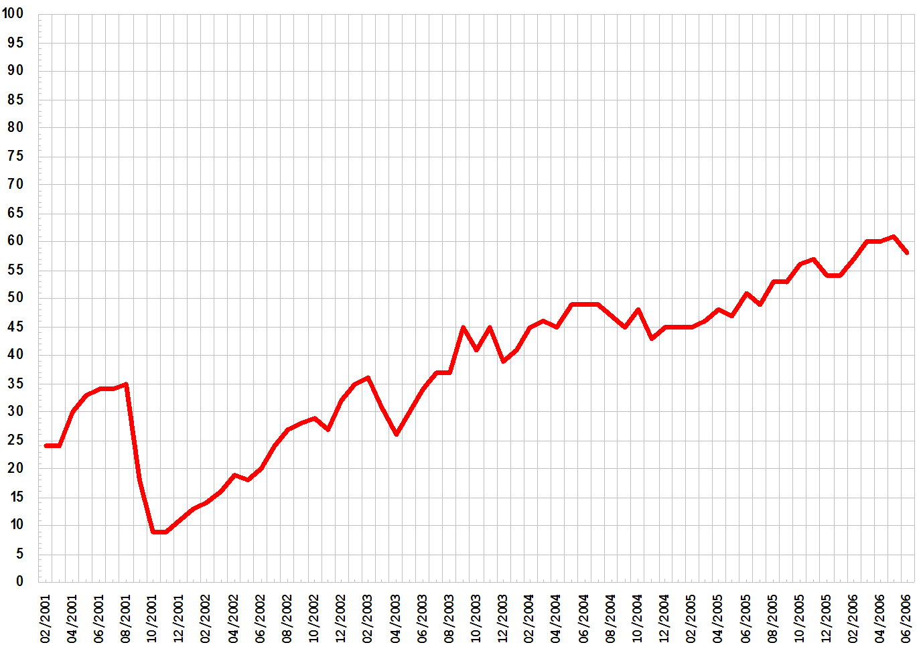
Random Quizzing
Take quiz
Graph results individually
Graph results of table/room
Discuss theory and process
Notes:
Handout graphs
Collect Results

Slide 34
L to J process video

Slide 35
Name ________ period ____ Date____
Chapter 3 – The Constitution
This assignment reinforces learning outcomes 8, 11, 12, 14, 15, 16, 28, 29, 30, 31, &32. This assignment reinforces the following learning outcomes: Heritage influences political identity, the principals of government reflect the values of society, and democracy evolves from the theories of political philosophers.

Slide 36
Learning Outcomes
Use your resources
Write it as fact.
Don’t double up.
Is it essential?
Does it help get to the core standards?
What can I ask to see if they know it?
What can I ask to see if they can use it?

Slide 37
Where can you use this?
K-12
  Secondary
  Elementary
    Vocab
    SS
    Science
    ELA
    Math
    Other
http://ltojconsulting.com/
Elementary Math Example:
Candy bars sell for $0.25 each or a package of 12 for $3.50. If I want to buy 24 of them for Halloween, would it be cheaper to buy them individually or by the package?

Slide 38


Slide 39
Lessons Learned
Leadership is consistent and year round.
FOCUS!!!—Pick your top things to change and go after them like your hair is on fire!!!
Data doesn’t lie…use it
Non-negotiable list
Build a team….Good things happen to good people

Slide 40
TELL ME AGAIN HOW LUCKY I AM TO BE A PRINCIPAL...
I keep forgetting!

