Slide 1
2018 Legislative Session Preview
Off the record and Salishan Conference
January 25-26, 2018

Slide 2
Agenda
COSA Goals for 2018 Session
Session Calendar
Education Committees
Budget
Key Upcoming Legislation
Questions, Answers and Discussion

Slide 3
Key COSA 2018 Session Goals
Protect current funding levels in State School Fund, Measure 98, etc. – no cuts to K-12 related budgets
Pass COSA supported legislation to ensure continuation of transition services for students with modified diplomas (SB 1522), extend Open Enrollment law for one year (SB 1521), extend sunset for CTE teachers to work while retired (HB 4012); Oppose Class Size as a Mandatory Subject of Collective Bargaining (HB 4113)
Support reasonable efforts to enact revenue reform and contain cost drivers (PERS and OEBB)
Oppose unfunded mandates and/or new reports and reporting requirements

Slide 4
2018 Session – Key Dates
January 16 – Bill Filing deadline
February 5 – 2018 Session officially convenes
February 9 – First Chamber deadline to post work sessions for bills (exceptions: Ways and Means, Rules and Revenue)
February 15 – Bills must pass out of first chamber committee (same exceptions)
February 16 – Revenue Forecast

Slide 5
2018 Session – Key Dates
February 16 – Student Success Committee hearing (Tentative)
February 22 – Second Chamber deadline to post work sessions for bills (exceptions: Ways and Means, Rules and Revenue)
February 27 – Bills must pass out of second chamber committee (same exceptions)
March 11 – Constitutional Sine Die (35 days total)

Slide 6
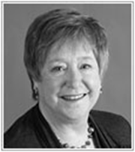
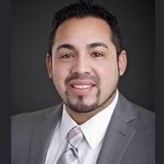
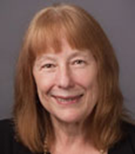
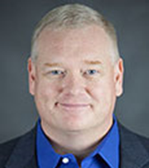
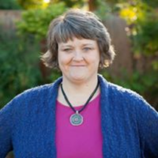
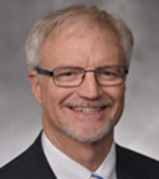
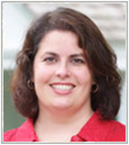
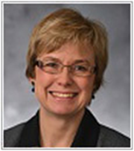
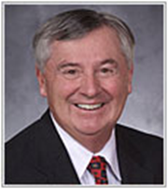
House Committee on Education
Meets every Monday and Wednesday at 3:00 pm
L to R: Rep. Doherty (D), Chair; Rep. Hernandez (D), Vice Chair; Rep. McClain (D); Rep. Evans (D); Rep. Sollman (D)
L to R: Rep. Wilson (R), Vice Chair; Rep. Parrish (R); Rep. Sprenger (R); Rep. Whisnant (R)

Slide 7
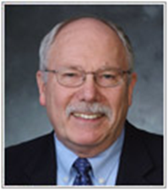
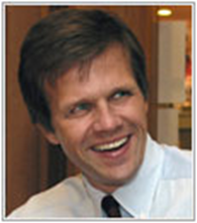
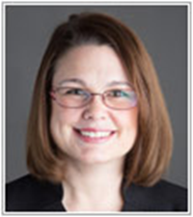
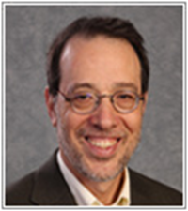
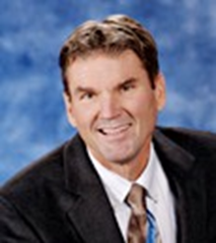
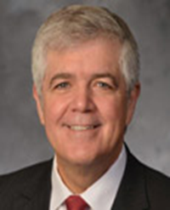
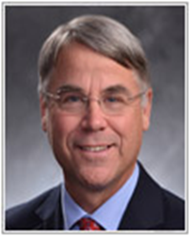
Senate Committee on Education
Meets Monday and Wednesday at 1:00 pm
L to R: Sen. Roblan, Chair (D), Sen. Hass (D), Sen. Gelser (D), Sen. Dembrow (D)
L to R: Sen. Linthicum, Vice-Chair (R); Sen. Bentz (R), Sen. Thomsen (R)

Slide 8
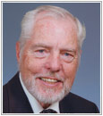
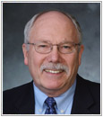
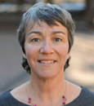
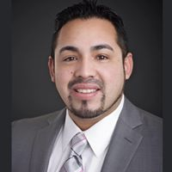
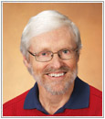
Ways and Means Subcommittee on Education
Meets Monday and Thursday at 8:30 am
Senate L to R: Sen. Monroe (D), Co-Chair; Sen. Roblan (D); Sen. Thomsen, (R)
House L to R: Rep. Smith-Warner (D), Co-Chair; Rep. Hernandez (D); Rep. Lively (D); Rep. Parrish (R); Rep. Whisnant (R)

Slide 9
2017-19 Budget
New Senate Ways and Means Co-Chair: Senate President Peter Courtney
Revenue Forecast Feb. 16 will outline impacts of federal tax changes
With passage of Measure 101, highly unlikely to be any changes to SSF, Measure 98, etc.

Slide 10
Issues and Bills of Interest in 2018
Future of Chief Education Office
Instructional Hours – State Board of Education
Student Success Committee
HB 4012 – Extends sunset allowing CTE teachers to work full time while retired
HB 4113 – Makes class size a mandatory subject of collective bargaining
SB 1521 – Extends Open Enrollment sunset one year (July 1, 2020)
SB 1522 – Allows students who receive modified diplomas to continue receiving transitions services until age 21 paid for by the SSF
SB 1540 – Clarifies that consensual sexual relations between minors are not subject to mandatory reporting law
SB 1566 – Governor Brown’s proposal to address PERS unfunded actuarial liability (UAL)

Slide 11
COSA Staff Are Here to Assist You
We want to hear from you when you have challenges or concerns in your districts. We are your voice in Salem.
We can assist with bills/legislation, working with your legislators or other elected officials, administrative rules, ODE or other state and federal agencies and much more!
Contact:
Chuck Bennett, Legislative Director chuck@cosa.k12.or.us
Morgan Allen, Deputy for Policy and Advocacy morgan@cosa.k12.or.us

